Slide 1
Diversification strategy for engine manufacturing company
Michael Medina
Jennyfer Puentes
Notes:
This presentation aims to illustrate the current trends of the existing industry this company exists within, and proposed infiltration into the industry of landscaping equipment manufacturing. At the end of this presentation, it is my goal to provide enough information about the existing and new industry for management to further their business activities, and ensure the continuation and growth of the company.

Slide 2
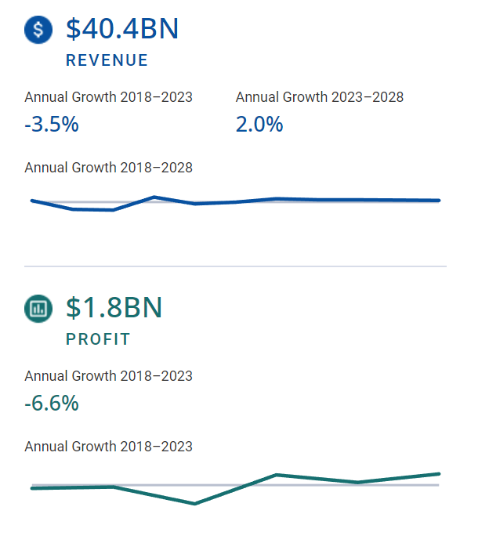
Current State of automotive manufacturing industry
Notes:
The current automotive manufacturing industry has demonstrated negative growth over the past 5 years.(ibisworld.com,2023) While projections display a positive growth in the next 5 years, it will not be much at only 2%.(ibisworld.com,2023) The new car market is also demonstrated to not be as strong as the used car market, with 6.2% growth per year within the same time period.(ibisworld.com) According to Caranddriver.com, "New vehicles made up 6.1 percent of vehicles on the road last year; IHS Markit predicts they will be closer to 5 percent this year."(2021)

Slide 3
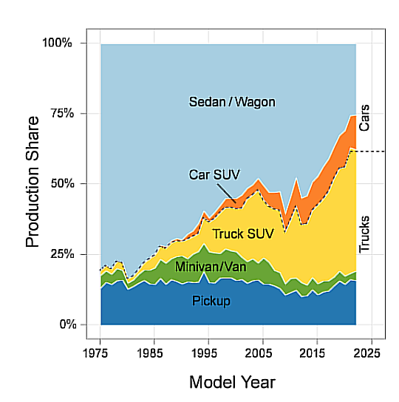
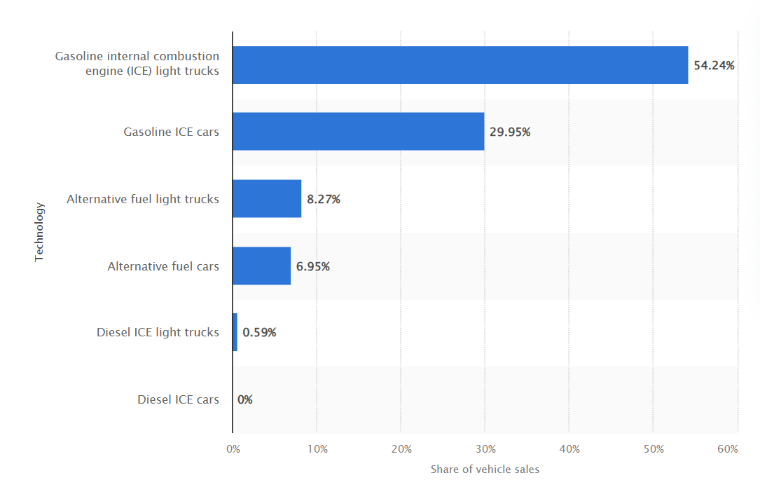
Sales and trends within the nation
Source:epa.gov,2023
Source:statista.com,2023
Notes:
Currently, over 80% of new light vehicles sales are gas powered on the roads, with less than 16% being alternative fuels. Over time since 1975, customers are also moving away from sedans and wagons, and more towards SUV's and trucks. According to the EPA, "In model year 2021, sedans and wagons fell to 26% of the market, well below the 50% market share they held as recently as model year 2013, and far below the 80% market share they held in 1975."(epa.gov)

Slide 4
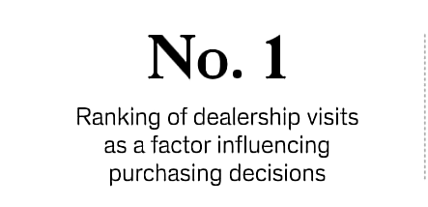
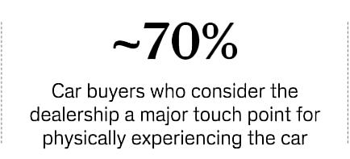
Trends continued
Source:surveysensum.com,2023
Source:pwc.com,2023
Notes:
Not only are customers demanding more trucks and utility vehicles, but they are also demanding more electric vehicle options for future purchases. This is evidenced by the PwC's report of "EV penetration in the US is expected to increase to 30% by 2030".(pwc.com,2023). Customers also express their large demand for a satisfactory dealership experience, with 70% of customers stating "the dealership [as] a major touch point for physically experiencing the car".(surveysensum.com,2023) Quality is the second most important factor, followed by vehicle features. Brand affiliation is the least important factor for American customers. (deloitte.com,2023)

Slide 5
Government intervention within industry
Source:kbb.com,2021;apnews.com,2023
Notes:
From beginning in 1970s, the government has introduced many laws and regulations concerning cars, engines, and their emissions. In 1970, the first clean air act required "90 percent reduction in emissions from new automobiles by 1975“, and again when President Joe Biden produced an executive order for "zero-emissions vehicles to make up half of new cars and trucks sold by 2030".(epa.gov,2023;apnews.com,2023)

Slide 6
Customer demands continued
Notes:
With growing demand for electric vehicles and customer interest in the idea, numerous large players within the industry have been altering operations to capitalize on this trend. "In June 2021, Audi announced that it will stop manufacturing diesel & petrol cars from 2033. Audi aims to have more than 20 e-models in its line-up by 2025."(Forbes.com,2021) "German automobile giant Volkswagen has announced it would stop the production of engine run cars by 2023-2035 period in Europe."(Forbes.com,2021) "Mercedes-Benz is planning to phase out the ICE vehicles by 2039."(Forbes.com,2021) Sweden manufacturer Volvo is planning to have only EVs in its global product line-up by 2030.”(Forbes.com,2021)

Slide 7
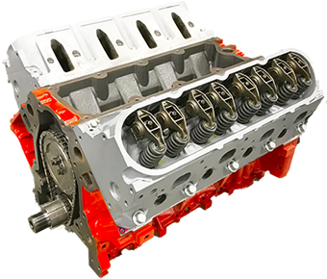
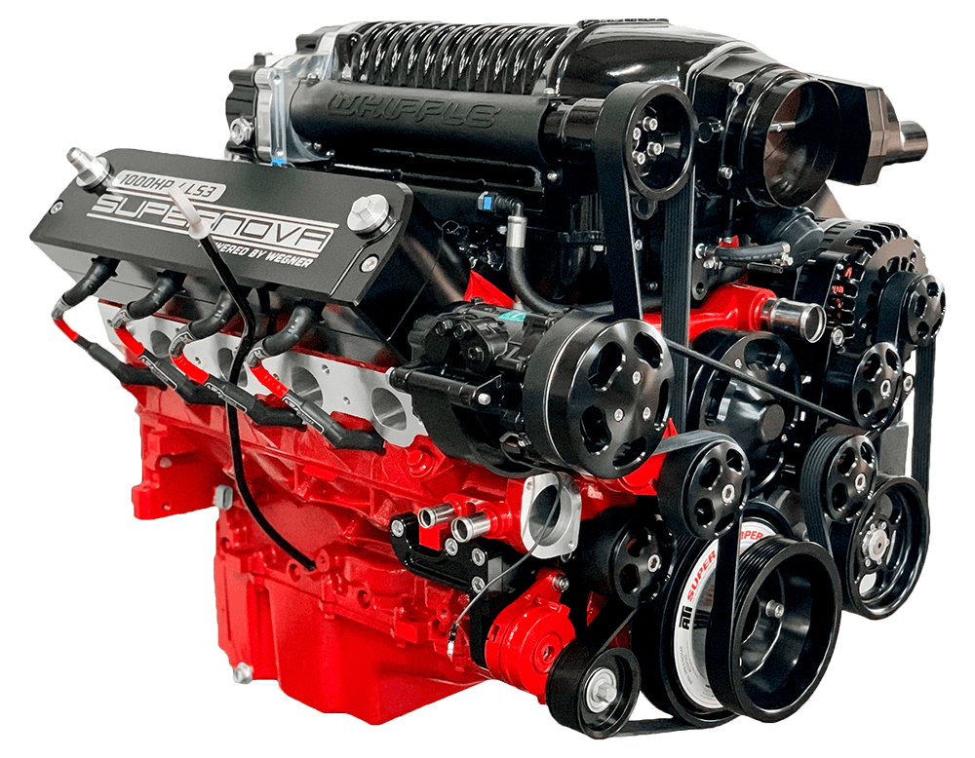
Automotive engine manufacturing trends
Average engine size in 1975: 4.8 Liter
Average engine size in 2021: 2.9 Liter
Source: motortrend.com,2022
Photo 1
Photo 2
Notes:
Engine manufacturer Cummins witnessed their segment shrink "by 2% to 32% in 2020", demonstrating a lower demand for large engine displacements, with it making 2.8 to 15L engines. (mobilityforesights.com) "In US, the average size of engine is 3.5L among the top 10 selling vehicles“(mobilityforesights.com) The average engine size “peaked at 4.8 liters all the way back in 1975“. In 2021, this displacement was 2.9 liters. (motortrend.co,2022) This difference in engine sizes demonstrates a “84 percent increase in horsepower and a 40 percent increase in displacement” for gas engines.(motortrend.co,2022) “The average car in 2021 was something with around 250 horsepower from a sub-3.0-liter engine.” (motortrend.co,2022)

Slide 8
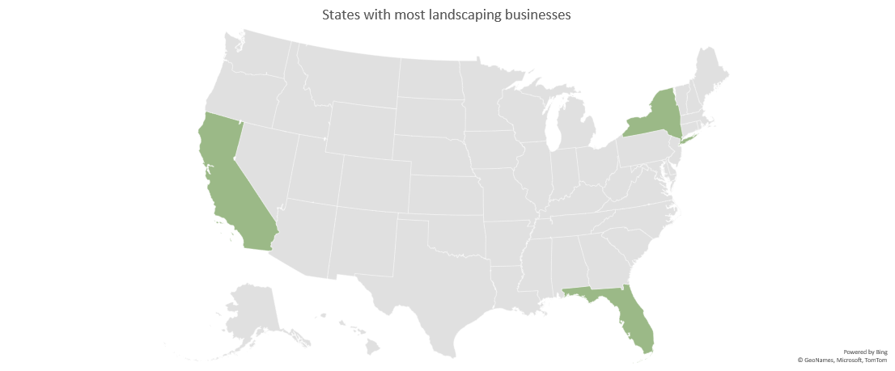
Landscaping manufacturing sales
88.10 billion USD market for global gardening equipment in 2022
6% growth rate compared to 2% for current industry
Source: grandviewresearch.com,2023
Source: landscapeprofessionals.org,2023
Notes:
My proposed diversity plan exists within landscaping manufacturing. Within a report by the national association of landscaping professionals, California, New York, and Florida were the "states with the most number of landscaping businesses in the U.S"(2023). The average landscaping company has 305 customers and generates $12,798 per customer.(landscapeprofessionals.org,2023)

Slide 9
Sales by Type of Product
Main Factors Driving Trend
“performance”
“run-time”
“cost”
Source: timesofsandiego.com,2021
Source: timesofsandiego.com,2021
Notes:
The residential sector, which includes services like maintenance and overhauls of land and backyards, is the largest and fastest-growing segment of the industry “set to observe 5.5% growth between 2023 and 2032".(gminsights.com,2022) ) Lawnmowers are the most popular product, with a market size of $7.1 billion in 2021 and a projected size of $9.7 billion by 2027.(arizton.com,2022) The main factor affecting the industry growth is the preference of 80% of landscapers for gas-powered equipment over electric ones, due to performance, run-time, and cost. (timesofsandiego.com,2021)

Slide 10
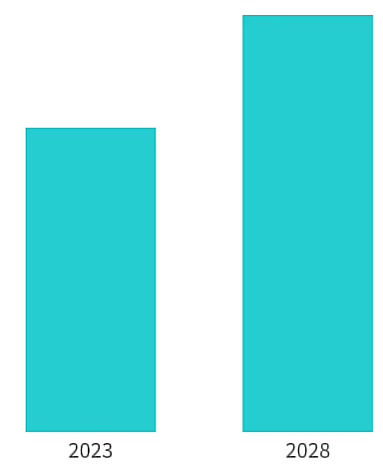
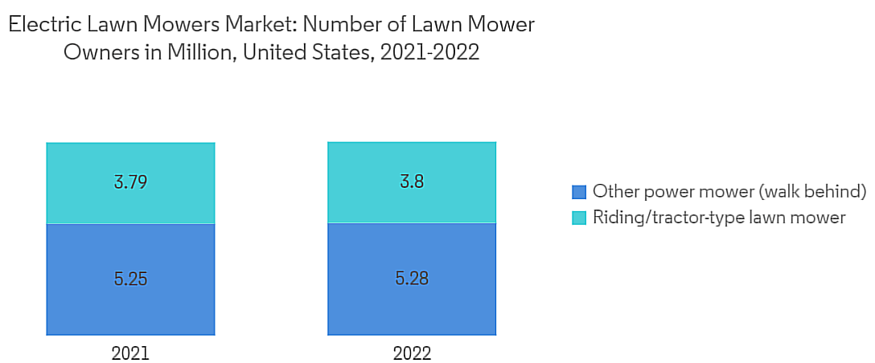
Customer Demands
“The Electric lawn mower market is projected to register a CAGR of 6.5% during the forecast period”
Source:mordorintelligence.com,2023
Source:mordorintelligence.com,2023
Notes:
Demands differ between commercial and personal use. For commercial, Gas-powered equipment is the dominant segment, with a value of $25.5 billion by 2032.(gminsights.com,2022). Residential or personal use desires more electric alternatives, with a 6.5% growth in electric lawnmowers alone with a high demand in north america. According to mordorintelligence.com, "Electric ride-on electric mowers are gaining popularity among end-users due to their declining costs and the introduction of low-cost models by vendors such as Ryobi."

Slide 11
Expected Growth
Source:grandviewresearch.com,2023
Notes:
The landscaping manufacturing industry was valued at $88.1 billion in 2022 and is expected to grow by 6.0% annually from 2023 to 2030. (grandviewresearch.com,2023) The automotive engine market is projected to grow by a mere 2% until 2028, 66% lower than the increase in landscaping equipment manufacturing until 2030 at 6% growth.

Slide 12
Summary of Data
Most important points to reiterate:
high growth for landscaping engines
66% increase in growth for the overall industry
low desire for alternative technologies
88.1 billion in 2022 compared to the current industry's 40.40 billion the same year.
Notes:
Most important points they communicate are the differences in profits and growth between the two industries and the lower threats of electrification that exist within the landscaping manufacturing The visuals aim to demonstrate that as customers demand more electrification, manufactures will have to either invest in this technology or be phased out in the future. For the current company, this can just as easily happen if they do not diversity into a market which is not so heavily invested in this technology. The visualizations convey that the new industry is a very safe way for the company to exist and growth without fear of emerging eliminations or requirements of high investments in new operations. As the company already owns and operates within engine manufacturing, it can easily take its expertise and reputation over to this new industry without having to pay for any large costs associated with entering this market. The data presented suggests that diversification would not only seek to solve the problem of a diminishing gas powered new car market, but ensure that the company can attain future growth in a new industry. As show within the visualizations, engine manufacturing within landscaping equipment is very profitable, and with the issue of electrification overwhelming the new car manufacturing market, this diversity strategy can solve this problem.

Slide 13
Decision-Making Model
Both models use past experience and quick thinking.
-intuitive model is more impulsive
-recognized prime model is more rational with research and analysis.
I chose recognized prime model because the company is losing money and customers fast. It needs to act now or face worse losses.
Notes:
After considering each decision-making model, from rational, intuitive, to recognition-primed, each has its advantages and disadvantages. For decision-making, this model allows for the most researched and broad span of options to select from when producing an action. However, this comes with the sacrifice of time as well as a team agreement, which can require more time to select one action to take. For the intuitive model, the quick decision making from one individual allows for an executive action to produce immediate results, but has the drawback of failure to consult others or consider the decision in a deeper manner. For recognized prime model, this exists as a mixture of the two previous models with quick decision making and utilization of research, but still fails to conduct extensive research on all viable alternatives. Even so, the latter model is what the company should implement within the diversification plan because of my extensive experience within this industry giving me an insider education on the role of machinery and market trends that a company could not. While this company can conduct research on its own, this is only from an outside perspective and does not enter within the actual customer perspective as a landscaper or a salesman approach would for this industry. This is where my expertise would come in, as diversification strategy in general best suits this model through step four of the process. "Consider if the solution works: Think through your solution to determine if it can really solve your challenge. Start by considering the most obvious issues and then consider the smaller details of the solution." As stated previously, the automotive industry is becoming increasingly electric, and unless this company desires to purchase and upgrade its facilities to keep up with this trend, its best option is diversification into a market where it can use what is already has immediately. With this issue resolved, the smaller details such as what machinery can the engines be produced for begin to be answered.

Slide 14
References
Arizton. (2022). U.S. lawn mower market - industry outlook and forecast 2022-2027. https://www.arizton.com/market-reports/united-states-lawn-mower-market
Carlier, M. (2023, April 25). U.S. light vehicle sales by Fuel Type 2022. Statista. https://www.statista.com/statistics/667282/united-states-light-vehicle-sales-by-technology-type/
Daly, M., & Krisher, T. (2023, April 10). AP sources: Epa Car Rule to push huge increase in EV sales. AP News. https://apnews.com/article/biden-electric-vehicles-epa-tailpipe-emissions-31bf8104f44d81b988249483f1a79117
Environmental Protection Agency. (n.d.). Timeline of Major Accomplishments in Transportation, Air Pollution, and Climate Change. EPA. https://www.epa.gov/transportation-air-pollution-and-climate-change/timeline-major-accomplishments-transportation-air
Environmental Protection Agency. (2022, December 12). Highlights of the Automotive Trends Report. EPA. https://www.epa.gov/automotive-trends/highlights-automotive-trends-report
Global Automotive Engine market 2023-2030: July 2023 updated. Mobility Foresights. (2023, June 8). https://mobilityforesights.com/product/automotive-engine-market/
Global Market Insights. (2022). Lawn & garden equipment market size by power (manual, electric, gas), by product (hand tools, lawnmowers, trimmers & edgers, water management equipment), by end-use sector (residential, commercial/government), industry analysis report, regional outlook, growth potential, price trends, competitive market share & forecast, 2023 - 2032. https://www.gminsights.com/industry-analysis/lawn-and-garden-equipment-market

Slide 15
Grand View Research. (2023). Gardening equipment market size, share & trends analysis report by product, by end user, by distribution channel, by region, and segment forecasts, 2023 - 2030. https://www.grandviewresearch.com/industry-analysis/gardening-equipment-market IBISWorld. (2023). Automotive engine & parts manufacturing in the US - market research report. https://my-ibisworld-com.ezproxy.snhu.edu/us/en/industry/33631/industry-at-a-glance Mordor Intelligence. (n.d.). Electric Lawn Mowers Market Size & Share Analysis - Industry Research Report - Growth Trends. Retrieved from https://www.mordorintelligence.com/industry-reports/electric-lawn-mowers-market Motavalli, J. (2022, October 27). Every automaker’s EV plans through 2035 and beyond. Forbes. https://www.forbes.com/wheels/news/automaker-ev-plans/ Times of San Diego. (2021, October 8). Landscapers decry high cost of new California mandate to buy electric tools. https://timesofsandiego.com/business/2021/10/08/landscapers-decry-high-cost-of-new-california-mandate-to-buy-electric-tools/ Tucker, S. (2023, January 17). New car sales fell in 2022, but new electric car sales rose … Kelley Blue Book. https://www.kbb.com/car-news/new-car-sales-fell-in-2022-but-new-electric-car-sales-rose-dramatically/ Westbrook, J. (2022, February 11). America’s new cars make more power than ever. MotorTrend. https://www.motortrend.com/news/epa-new-car-record-high-horsepower/ Photo 1: https://www.sandjengines.com/promos/chevrolet-gm-vortec-4800-ly2-lr4-ls-silverado-long-block-crate-engine-sale Photo 2: https://www.wegnerautomotive.com/engine-packages/376-ci-whipple-2-9l-supercharged-ls3/
References

